Slide 1
Anthem Flex for Weed Control in Peanut
Eric P. Prostko
Professor and Extension Weed Specialist
Department of Crop & Soil Sciences
FMC Technical Meeting
Oct. 2, 2019

Slide 2
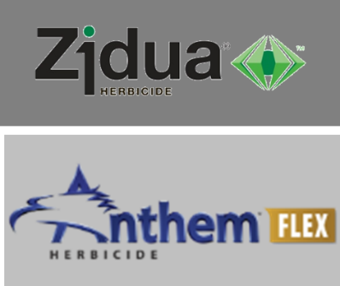
Pyroxasulfone
Formerly KIH-485
Isoxazoline family
fenoxasulfone
WSSA MOA #15
VLCFA inhibitor
Same as Dual or Warrant
Discovered by Kumiai Chemical
Marketed by BASF (Zidua), FMC (Anthem/Anthem Flex), and Valent (Fierce)

Slide 3
Chemical Properties
Herbicide | Water Solubility (ppm) | Soil Binding (K_{oc}) | Soil ½ Life (days)
acetochlor | 223 | 165 | 12
pyroxasulfone | 3.49 | 114 | 22
S-metolachlor | 488 | 200 | 20

Slide 4
Pyroxasulfone/Peanut Research in Georgia
2007-2019
59 pyroxasulfone field trials
11 with Anthem Flex
Crop Tolerance
Weed-free
Weed control
Tank-mixes

Slide 5
Pyroxasulfone in Peanut General Summary
Should not be applied PRE!!!!!!
Excellent POST tolerance
Tank-mix with Gramoxone, Cadre, Cobra, or Ultra Blazer
+ NIS
Pyroxasulfone tank-mixtures with fungicides have been fine (Tilt/Bravo, Abound, Fontelis, Provost, Priaxor, Artisan, Absolute)

Slide 6
Irrigated Peanut Yield Response to PRE Applied Proxasulfone
-7%
a
ab
Source: Eure et al. 2015. Peanut Science 42:39-43
*Pooled over 3 cultivars (GA-06G, GA Greener, Tifguard) and 2 site-years (2012, 2013)

Slide 7
Irrigated Peanut Yield Response to PRE Applied Pyroxasulfone
-19%
PE-01-15
GA-06G
LSD 0.10 = 906
CV = 13.06

Slide 8
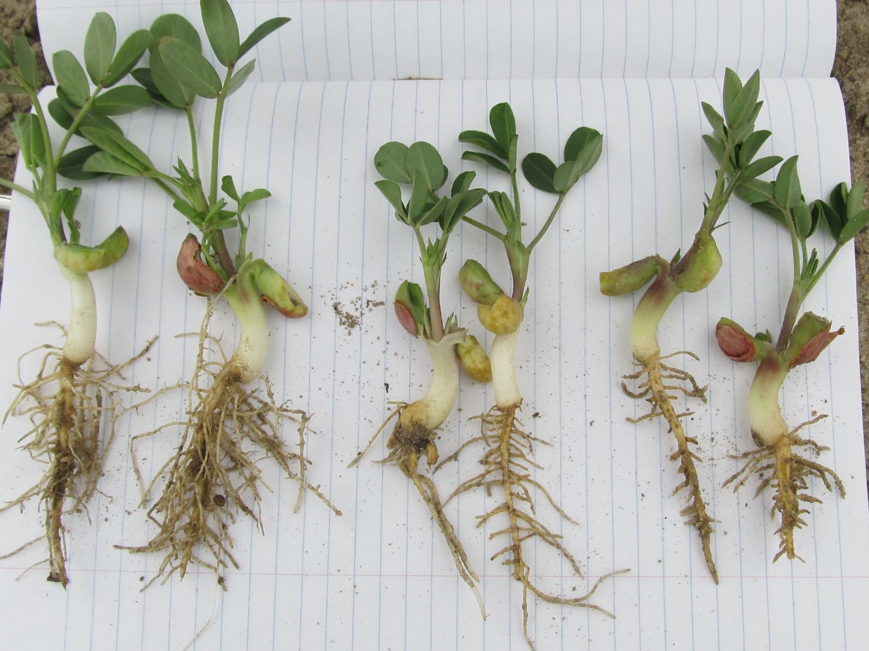
PE-14-13, May 1, 15 DAT
Georgia-06G
Pyroxasulfone
0.079 lb ai/A
(1.5 oz/A 85DG)
Pyroxasulfone
0.159 lb ai/A
(3 oz/A 85DG)
NTC

Slide 9
Peanut Injury with Pyroxasulfone – 22 DAT (lb ai/A)
NTC
0.087
0.109
0.174
0.219
PE-01-15
May 19

Slide 10
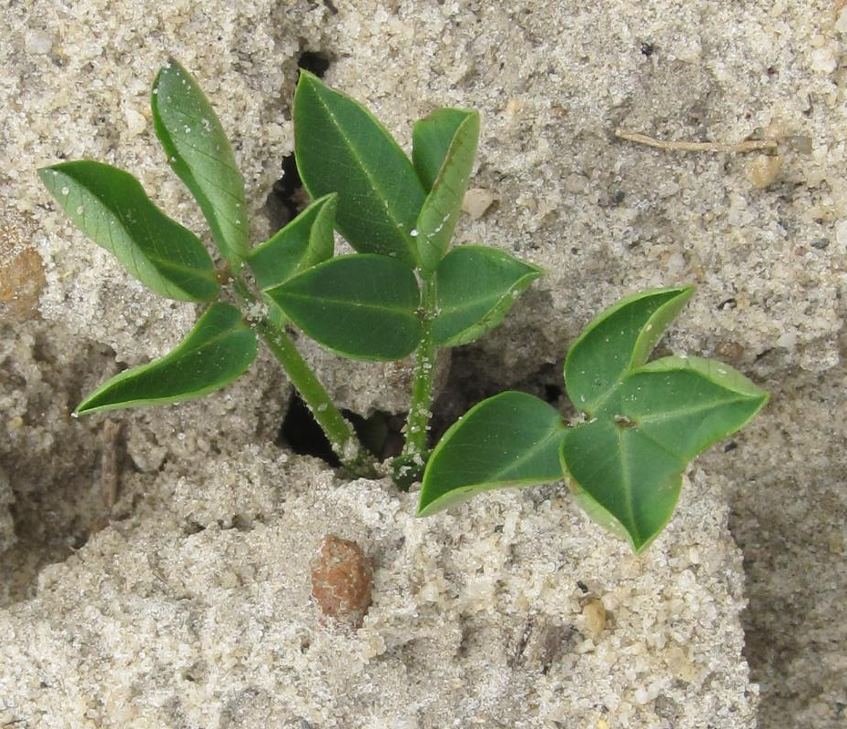
Peanut Leaf Cupping Caused by Pyroxasulfone Applied PRE

Slide 11
Anthem Flex in Peanut
FMC
Anthem Flex 4SE (F9312-3)
carfentrazone (0.267 lb/gal)
pyroxasulfone (3.733 lbs/gal)
Testing since 2012
POST only!
Increase in crop injury mostly due to carfentrazone
2.7-3.0 oz/A + NIS
0.0056 - 0.0063 lb ai/A – carfentrazone
Aim 2EC @ 0.36-0.40 oz/A
0.0787- 0.0875 lbs ai/A – pyroxasulfone
Zidua 85WG @ 1.48-1.65 oz/A or Zidua 4.17SC @ 2.42-2.69 oz/A

Slide 12
Weed Control in Peanut with Anthem Flex - 2017
PROWL H₂0 3.8 SC 32.0 oz/A (PRE)
VALOR SX 51 WG 3.0 oz/A (PRE)
STRONGARM 84 WG 0.225 oz/A (PRE)
CADRE 2 AS 4.0 oz/A (42 DAP)
ANTHEM FLEX 4SE 3.0 oz/A (42 DAP)
NIS 0.25 % v/v (42 DAP)
PE-04-17
July 20
79 DAP
NTC

Slide 13
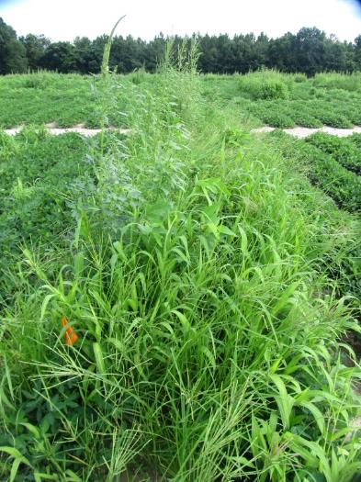
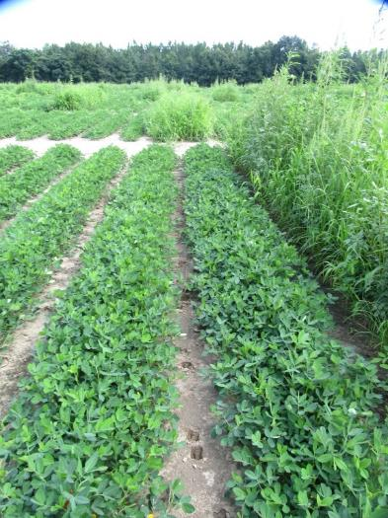
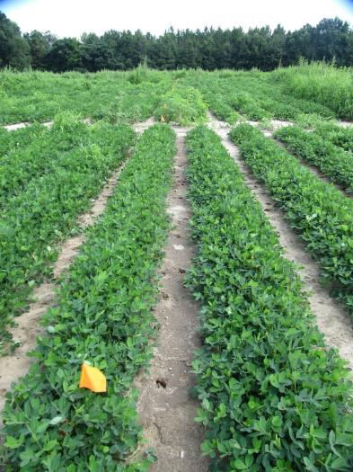
Weed Control in Peanut with Anthem Flex - 2018
NTC
Prowl H₂0 @ 32 oz/A – PRE
Gramoxone @ 12 oz/A - 16 DAP
Storm @ 16 oz/A - 16 DAP
Dual Magnum @ 16 oz/A -16 DAP
Cadre @ 4 oz/A - 38 DAP
Dual Magnum @ 16 oz/A - 38 DAP
Prowl H₂0 @ 32 oz/A – PRE
Gramoxone @ 12 oz/A - 16 DAP
Storm @ 16 oz/A - 16 DAP
Anthem Flex @ 3 oz/A -16 DAP
Induce @ 0.25% v/v
Cadre @ 4 oz/A - 38 DAP
Anthem Flex @ 3 oz/A - 38 DAP
Induce @ 0.25% v/v
PE-15-18
July 17
71 DAP

Slide 14
Gramoxone + Storm + Anthem Flex
PE-02-15
May 19
1 DAT

Slide 15
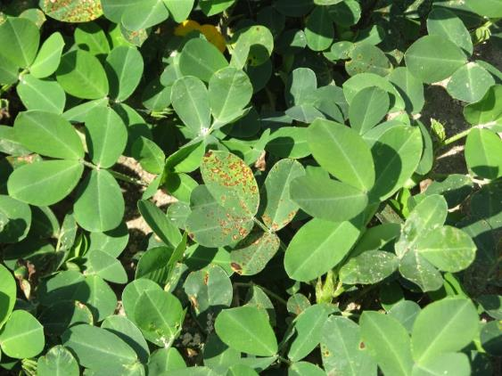
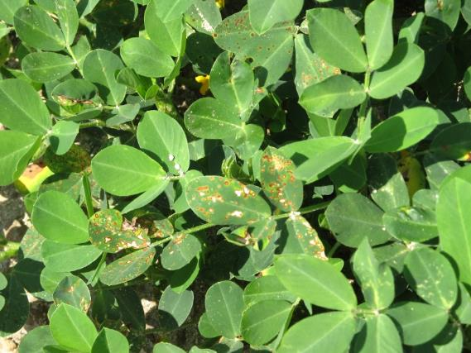
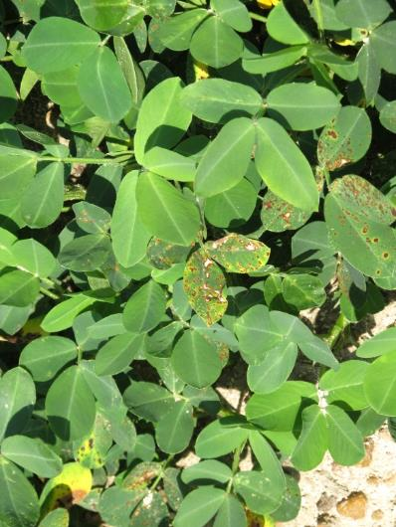
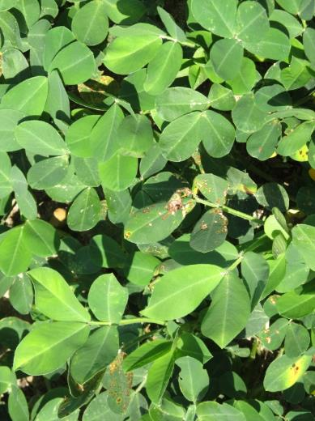
Anthem Flex Injury from POST Applications
PE-12B-14
June 19
9 DAT

Slide 16
‘GA-06G’ Yield Response to Anthem Flex 4SE + NIS Applied Postemergence (15-31 DAP) in GA.
lbs/A
PE-01-15
PE-10-16
weed-free
irrigated
LSD (0.10) = 906
CV = 13.06
LSD (0.10 ) = NS
CV = 8.37

Slide 17
Other Peanut Yield Data
In weedy tests (PE-02-15, PE-04-17), no differences in peanut yield were observed when Anthem Flex was substituted for Dual Magnum in standard treatments such as…..
Prowl + Valor + Strongarm (PRE) fb Cadre + Dual Magnum (35-42 DAP)
Prowl (PRE) FB Gramoxone + Storm + Dual Magnum (15-21 DAP) fb Cadre + Dual Magnum (35-42 DAP)
Prowl + Valor + Strongarm (PRE) fb Cobra + + 2,4-DB + Dual Magnum (35-42 DAP)

Slide 18
Anthem Flex + Fungicides
Only 1 field trial (PE-03-15)
Tank-mixed with Tilt/Bravo, Abound, Fontelis, Provost, Priaxor, Artisan, Elast
Peanut leaf-burn was increased by 8-11% with Tilt/Bravo, Fontelis, Artisan, and Elast
No negative yield effects (P = 0.1373)
Anthem Flex @ 3.75 oz/A
Tilt/Bravo @ 32 oz/A
5 DAT
Anthem Flex @ 3.75 oz/A
Fontelis @ 18 oz/A
5 DAT

Slide 19
Some things I have heard said about pyroxasulfone?
Its way better than Dual (S-metolachlor) or Warrant (acetochlor) on pigweed, grasses, and annual mg??
IS IT ALWAYS BETTER???????
What about other weeds?
Florida beggarweed
wild radish

Slide 20
Annual Morningglory Control
Herbicide | TN | AR (PITTED) | LA | NC | MS | DE, MD, NJ, VA | KY | KS | OH, IL, IN
Dual Magnum | 2 | 0 | 2 | N (<25%) | NL | N (<55%) | 0 | - | - (<60%)
Warrant | NL | 0 | NL | N | NL | N | 0 | - | -
Zidua | 2 | 6 | 7 | N | 7 | N | 0 | F | -
Source: 2019 University Weed Control Guides from each state.

Slide 21
Texas Panicum Control with KIH-485 85WG
CN-08B-07
Attapulgus
Dual Magnum 7.62EC @ 16 oz/A
Prowl H₂0 3.3SC @ 34 oz/A

Slide 22
Annual Grass** Control with PRE Herbicides - 2016
SB-04-16
**Non-uniform mixture of Texas panicum, crabgrass, crowfootgrass, and goosegrass

Slide 23
Annual Grass** Control with PRE Herbicides - 2019
NC-02-19
**Non-uniform mixture of Texas panicum, crabgrass, crowfootgrass, and goosegrass

Slide 24
Palmer Amaranth Control with Zidua, Dual Magnum, and Warrant Applied PRE to Bare-Ground - 2011
Control (%)
Time (DAT)
NC-05-11

Slide 25
Palmer Amaranth Control with Zidua, Dual Magnum, and Warrant Applied PRE to Bare-Ground - 2016
Control (%)
Time (DAT)
NC-01-16

Slide 26
Palmer Amaranth Control with PRE Herbicides - 2016
SB-04-16

Slide 27
Palmer Amaranth Control with PRE Herbicides - 2019
NC-02-19

Slide 28
Florida Beggarweed Control with PRE Herbicides - 2016
Is this real?
SB-04-16

Slide 29
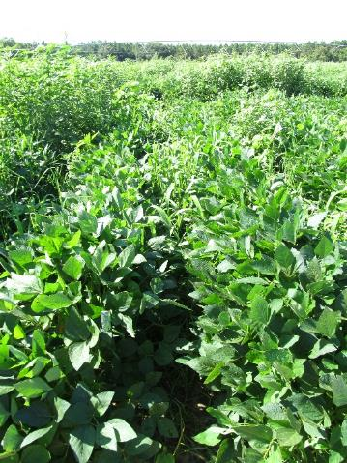
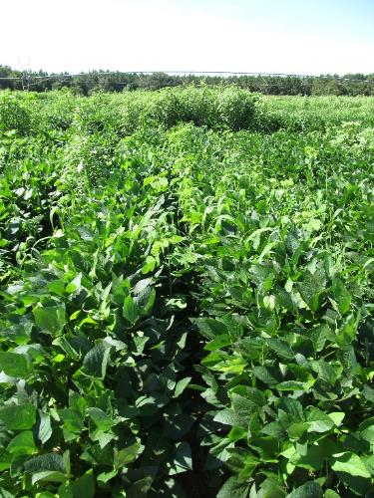
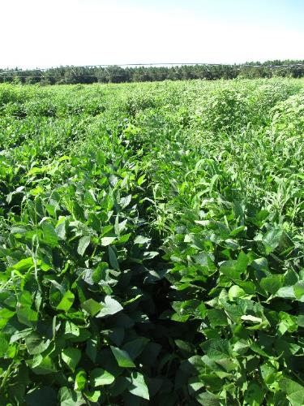
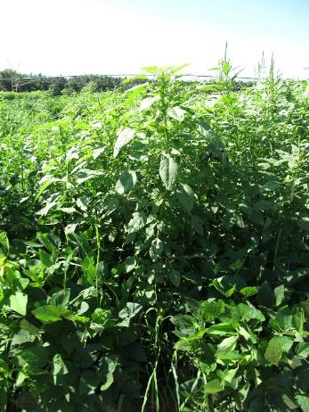
Residual Weed Control in Soybeans - 2016
NTC
Zidua 85WG
1.5 oz/A
(0.080 lb ai/A)
Dual Magnum 7.62EC
21 oz/A
Warrant 3ME
48 oz/A
SB-04-16
July 20
58 DAT

Slide 30
Wild Radish Control with PRE Herbicides - 2019
Is this real?
NC-02-19

Slide 31
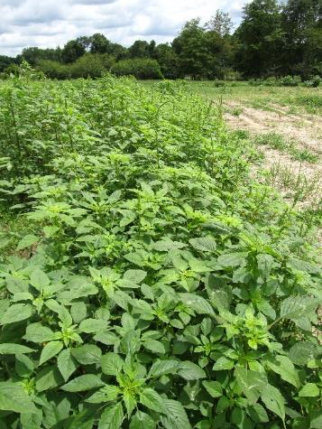
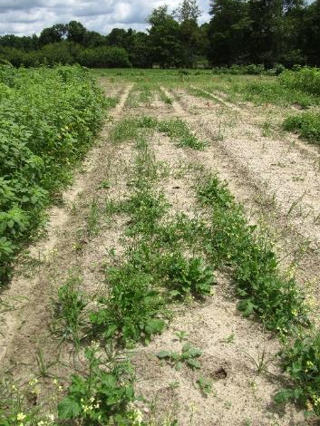
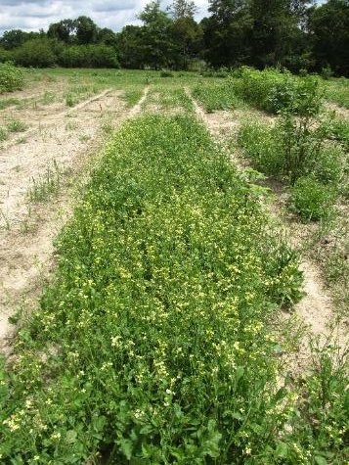
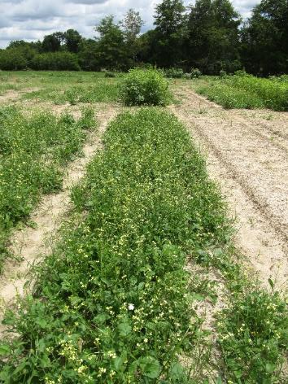
Weed Response to PRE Herbicides - 2019
NTC
Zidua 4.17SC
2.5 oz/A
(0.081 lb ai/A)
Dual Magnum 7.62EC
16 oz/A
Warrant 3ME
48 oz/A
NC-02-19
June 18
34 DAT

Slide 32
Final Thoughts?
Anthem Flex use rate in peanut?
2.7-3.0 oz/A
How much will Anthem Flex cost/A?
Zidua 4.17SC @ 2.5 oz/A (0.081 lb ai/A) = ~$11-$13
Dual Magnum 7.62EC @ 16 oz/A = ~$8/A
Warrant 3ME @ 48 oz/A = ~$7-8/A
Need more fungicide tank-mix data!
Miravis, Elatus, Lucento
Is pyroxasulfone really better (all the time) on IPOSP, RAPRA, and DEDTO?

Slide 33
Questions/Comments

